Slide 1
Output Devices

Slide 2
Output
Output is data that has been processed into a useful form, called information

Slide 3
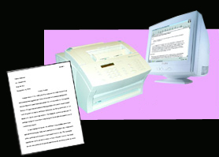
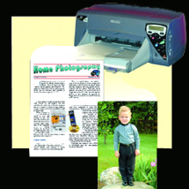
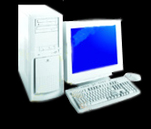
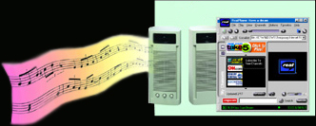
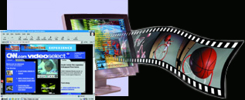
Output – Four Types
text
graphics
video
audio

Slide 4
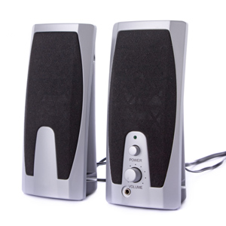
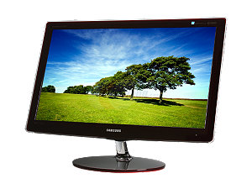
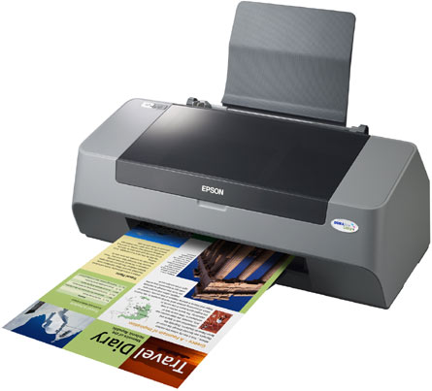
Output Device
An output device accepts processed data from the computer and presents the results to the user.

Slide 5
Display Devices
The most common form of output device is a display device.
Most computers today (as well as most television and mobile devices) use the thinner and lighter flat-panel displays.

Slide 6
Display Devices
Flat-panel technologies include:
  Liquid crystal display (LCD)
  Light emitting diode (LED)
  Organic light emitting diode (OLED)
  Interferometric modulator (IMOD) display
  Plasma display
  3D Display

Slide 7
Additive Color System
Display devices use the additive color system to create all of the colors you see on the screen.
Additive color use the three primary colors red, green and blue.
By combining them together in specific amounts you can create all color.

Slide 8
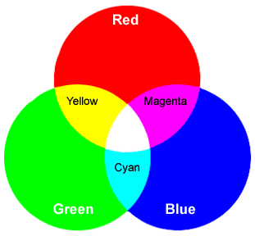

Additive Color System

Slide 9
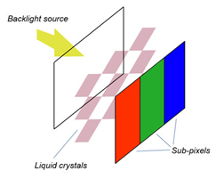
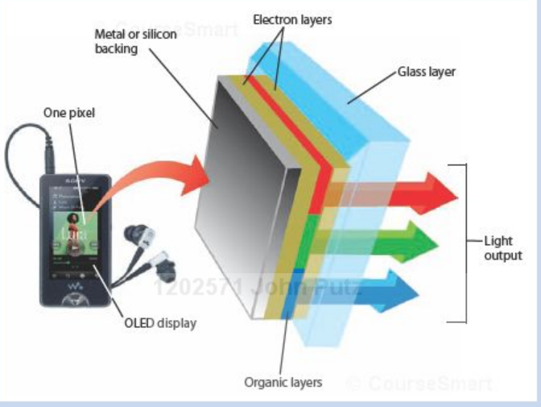
Display Technology
LCD Display
OLED Display

Slide 10
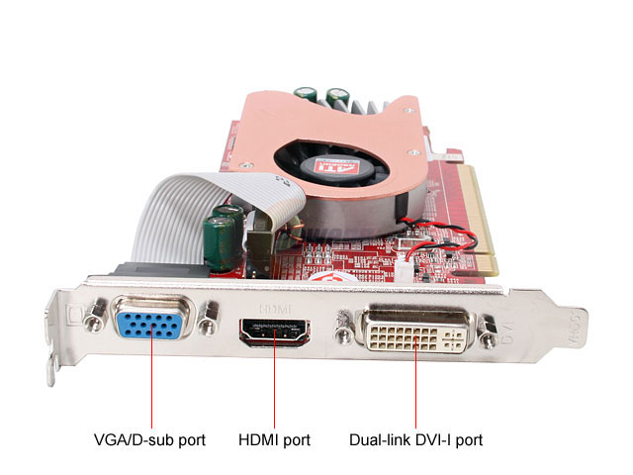
The Video Card
An expansion card added to a PC to improve the video output.
VGA/sub D
Port
HDMI
Port
DVI
Port

Slide 11
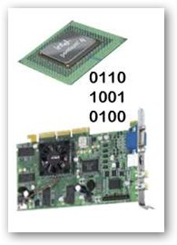
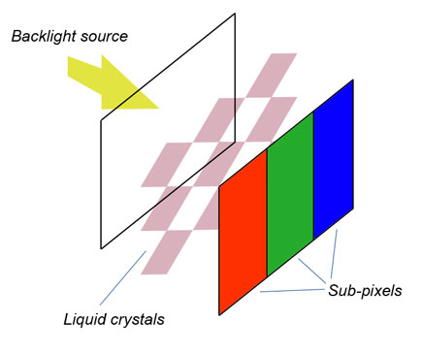
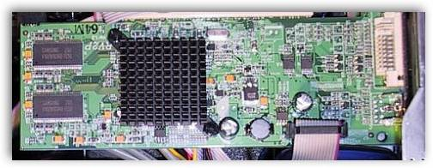
How Video is Sent to the LCD
Step 2. The video card’s digital-to-analog converter (DAC) converts the digital video data to an analog signal.

Slide 12
How Video is Sent to the LCD
Step 3. The analog signal is sent as a red, green and blue signal through a cable to the LCD monitor.

Slide 13
How Video is Sent to the LCD
Step 4. The display controller circuitry converts the red, green and blue analog signal using a analog to digital converter (ADC) to digital information.
Display Controller

Slide 14
How Video is Sent to the LCD
Step 5. The digital information is sent to the alignment layer for each of the red, green and blue sub-panel in the liquid pixel crystal
Display Controller

Slide 15
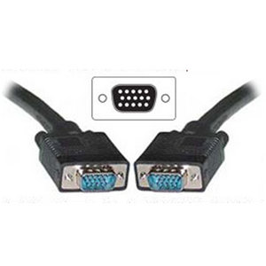
The 15 Pin Video Connector
The standard connection for a CRT or Flat Panel monitor is a 15 pin connector.
It is connected into the 15 pin video port on the PC.

Slide 16
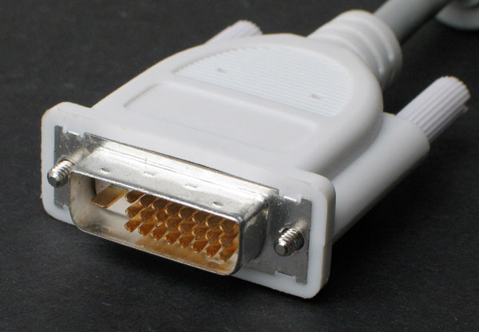
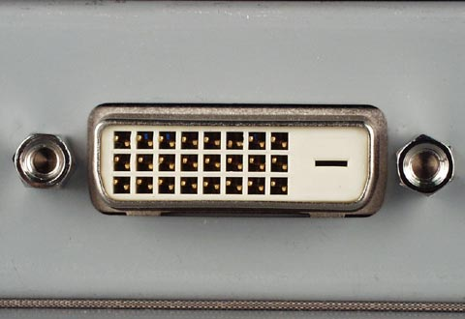
The DVI Video Connector
The DVI connector is a multi-pin connector that sends digital information
It is connected into the DVI n video port on the PC.

Slide 17
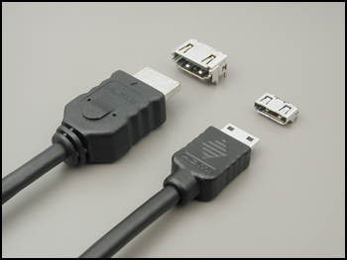
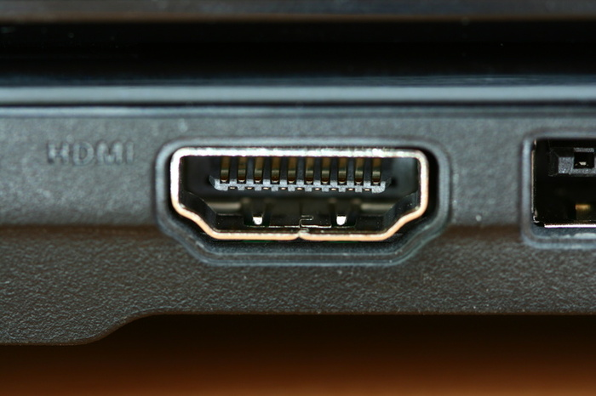
The HDMI Connector
HDMI (High-Definition Multimedia Interface) is a compact audio/video interface for transmitting encrypted uncompressed digital data
There is a standard and mini HDMI connector.

Slide 18
Data and Multimedia Projectors
A data projector is used to display output from a computer to a wall or projection screen.
  Freestanding units
  Permanently mounted onto ceiling
  iPod dock
  Integrated projector
  3D/Hologram projector

Slide 19
Printers
Printers are device that produces text and graphics on printer media.
Result is hard copy, or printout

Slide 20
Subtractive Color
Printing uses the subtractive color process.
The ink colors used are cyan, magenta, and yellow plus black.
This is called the CYMK system.
As white light strikes the ink on the surface colors are absorbed and what is left is what you see.

Slide 21
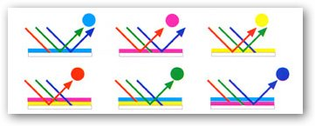
Subtractive Color

Slide 22
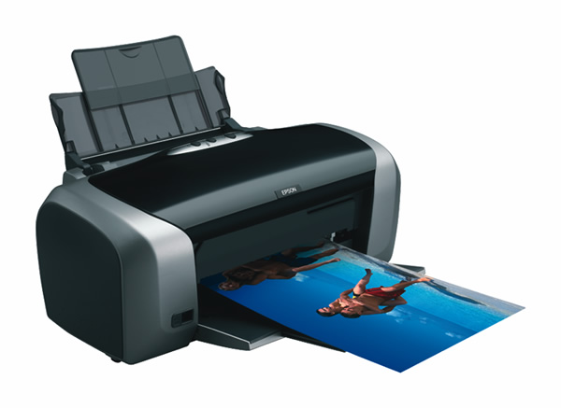
Inkjet Printers
Sprays tiny drops of liquid ink onto paper
This is a cold process

Slide 23
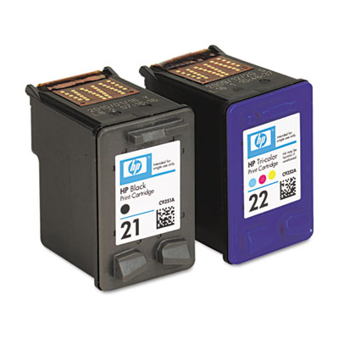
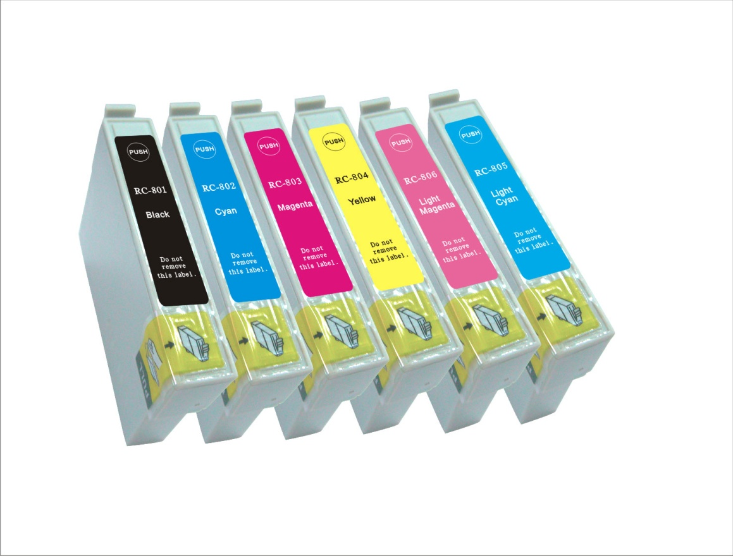
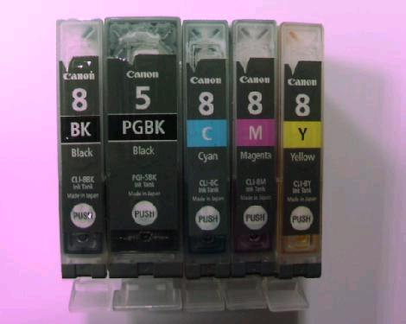
Inkjet Cartridges
Two cartridge systems
3 – 4 cartridge systems
Photo cartridge systems

Slide 24
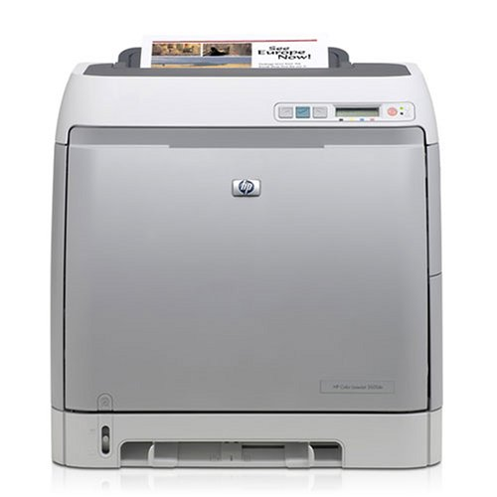
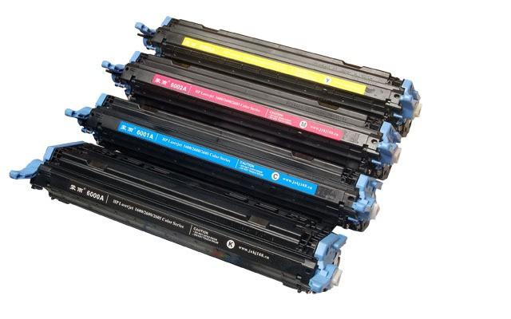
Laser Printers
Uses toner to create the image
This is a hot process

Slide 25
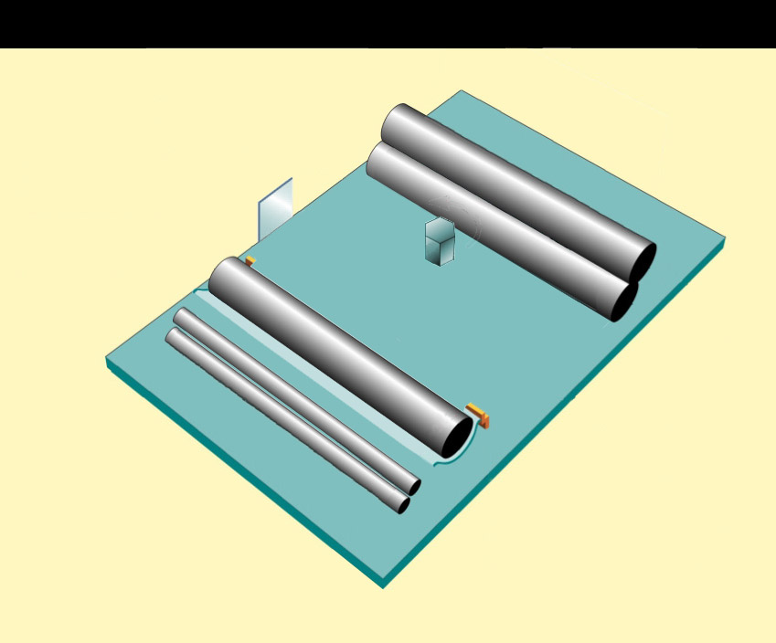
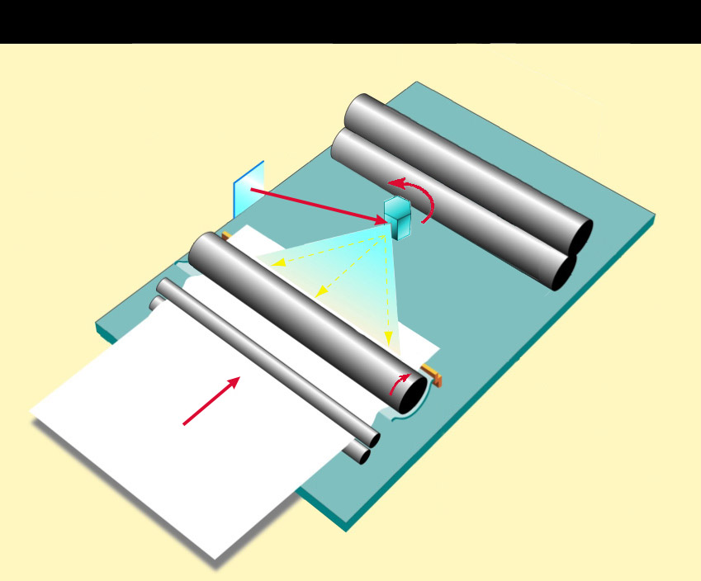
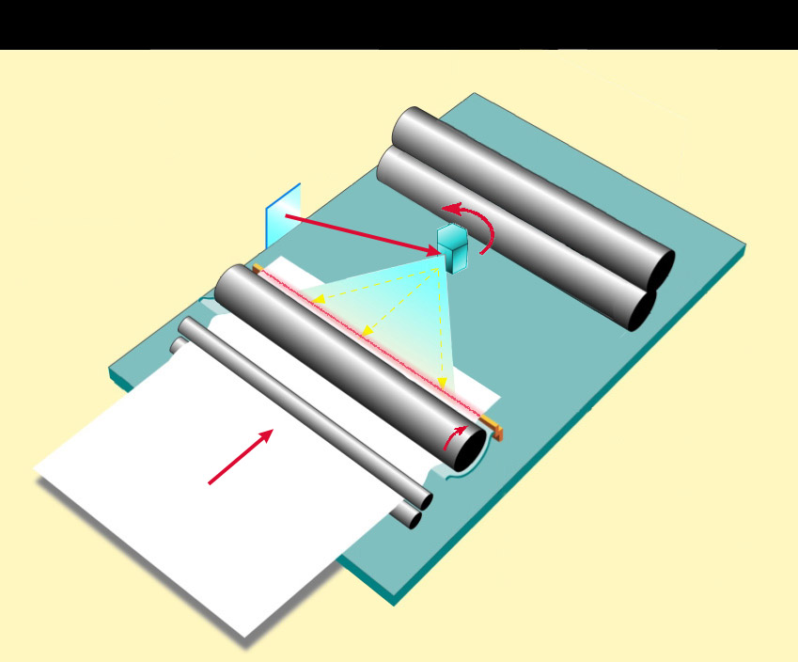
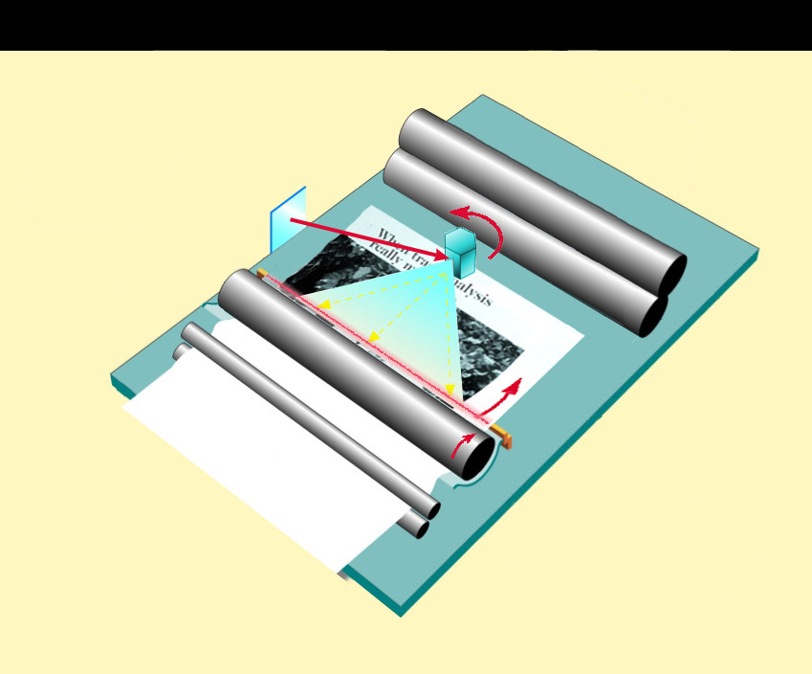
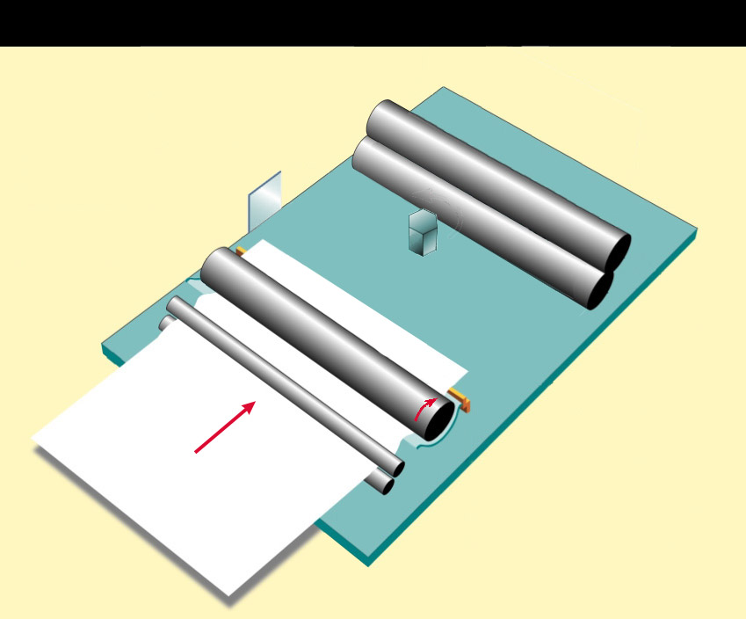
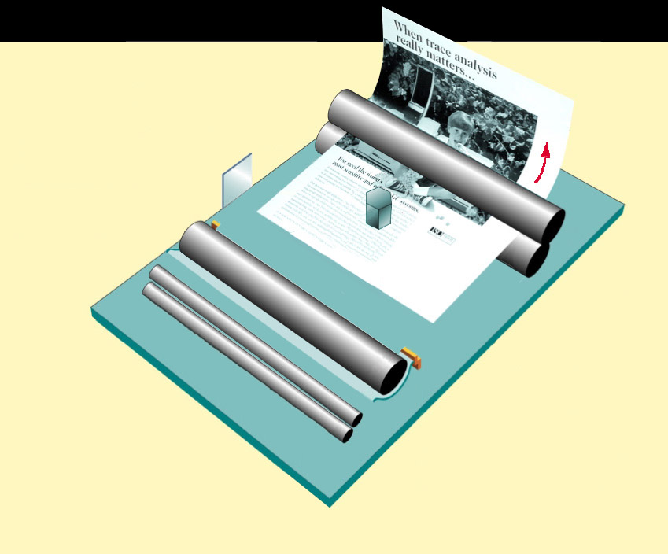
How a laser printer work
Laser printers
1: Drum rotates as paper is fed through
2: Mirror deflects laser beam across surface of drum
rotating mirror
rotating mirror
rotating mirror
rotating mirror
3: Laser beam creates charge that causes toner to stick to drum
drum
drum
drum
drum
drum
4: As drum rotates, toner transfers from drum to paper
rollers
5: Rollers use heat and pressure to fuse toner to paper

Slide 26
Printing Media
Specific types of media for specific types of printers
Plane paper
Coated paper
Photographic paper
Transparencies
Misc

Slide 27
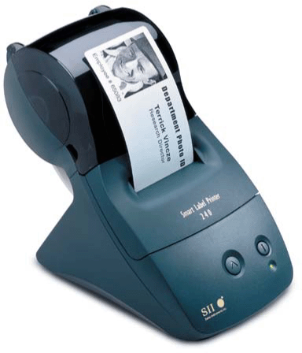
Thermal Printers
Generates images by pushing electrically heated pins against heat-sensitive paper
One specific type of thermal printer is the label printer

Slide 28


Dye-sublimation Printers
Uses heat to transfer dye to specially coated paper
Used to create high quality photographs

Slide 29
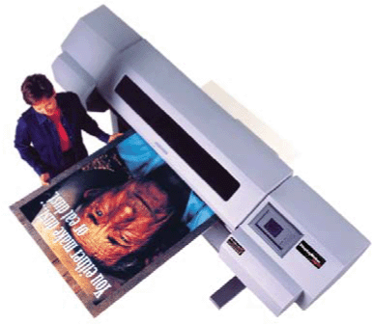
Plotters
Sophisticated printer used to produce high-quality drawings
Large-format creates photo-realistic-quality
color prints

Slide 30
Audio Output
Audio output includes voice, music, and other audible sounds.
Portable computers and mobile devices typically have peakers integrated into the device
mobile devices can also be connected to a stereo system or other consumer device that contains an iPod/MP3

Slide 31
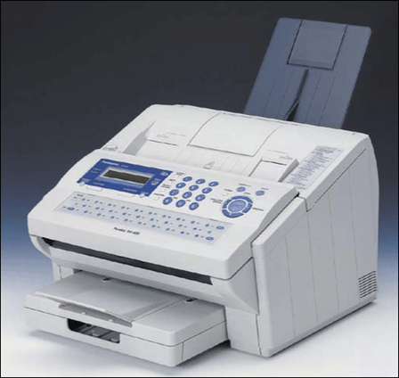
Multifunction Peripheral
Provides functionality of printer, scanner, copy machine, and fax machine

